Slide 1
Doctrine Basics
Introducing ORM Concepts and Doctrine framework,
Entities, Repositories

Slide 2
Contents
ORM Basics - Doctrine
Entity Manager
Entity Repository

Slide 3
ORM Basics - Doctrine
Doctrine DBAL, Doctrine ORM

Slide 4
What Is ORM?
ORM - Object Relational Mapper
Maps PHP objects to database table rows
Database independent
Has its own SQL-like language

Slide 5
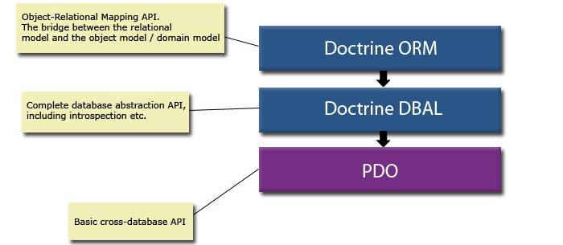
What Is ORM?

Slide 6
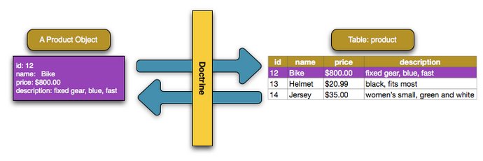
Doctrine ORM
Map database row to PHP object called Entity

Slide 7
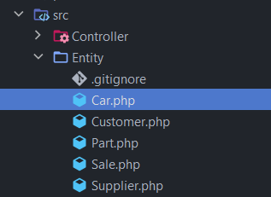
Doctrine ORM
Doctrine entities should live in src/Entity directory

Slide 8
Doctrine ORM
Doctrine Entity - Basic Mapping with Annotations
@Entity - tells Doctrine the class represents database table
@Column - the property represents database column
@Id - set property as entity primary key
@GeneratedValue - id generation mechanism

Slide 9
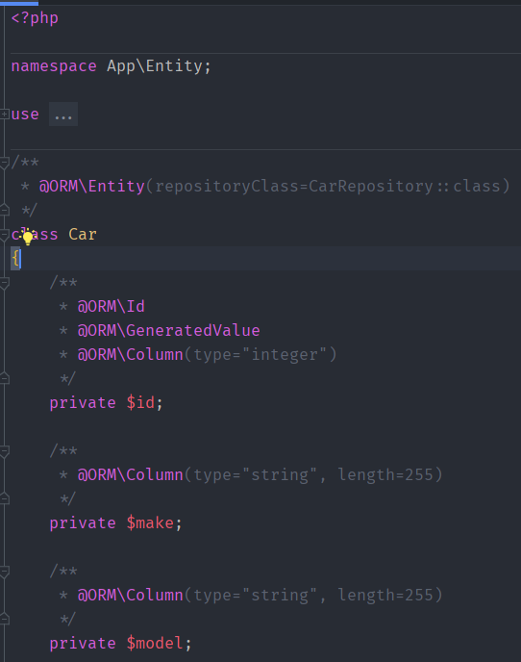
Doctrine ORM
Doctrine Entity

Slide 10
Doctrine ORM
Doctrine Entity
Doctrine entities should only represent database table structure
Do not execute SQL queries from your entities
Do not write heavy logic in your entity classes

Slide 11
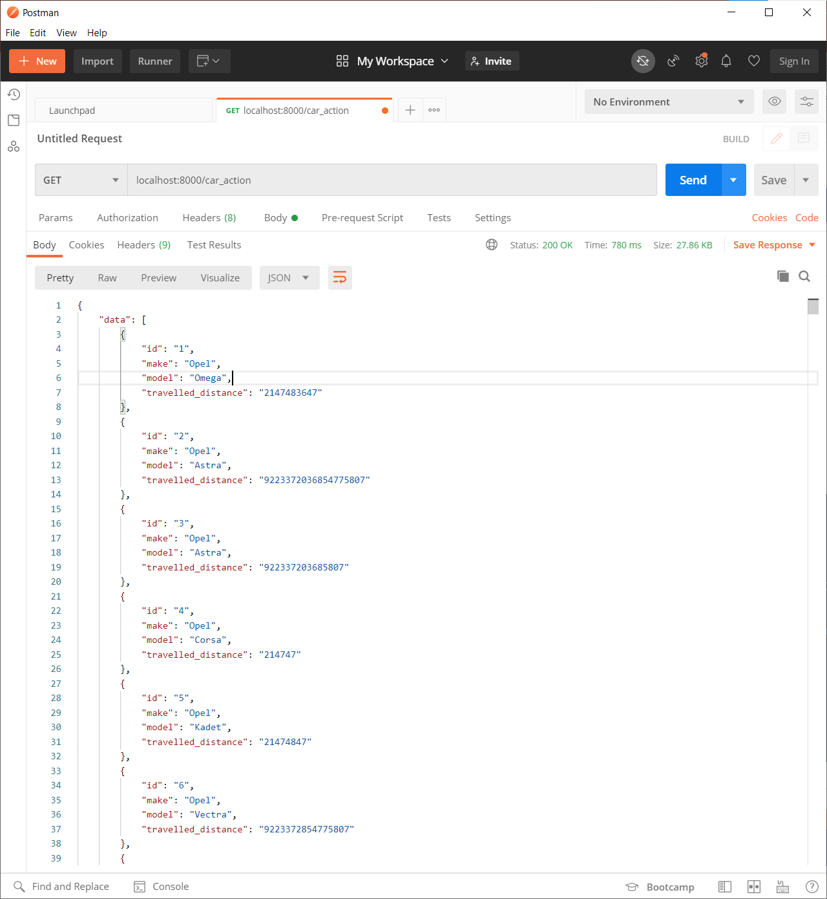
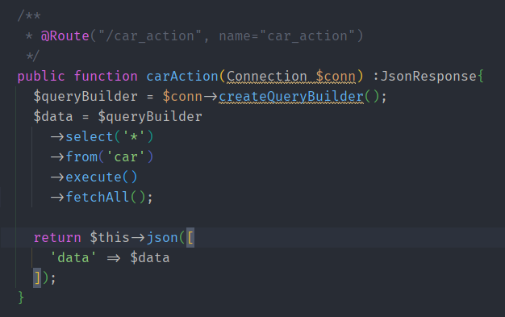
Doctrine DBAL
Data Base Abstraction Layer - built on top of PDO

Slide 12
Entity Manager
QueryBuilder, Persisting and Updating Entities

Slide 13
EntityManager
Manage entities - persist(), remove(), flush()
createQuery() - allows us to execute DQL queries
createNamedQuery() - allows us to execute named DQL queries
createQueryBuilder() - allows us to create queries using object-oriented approach

Slide 14
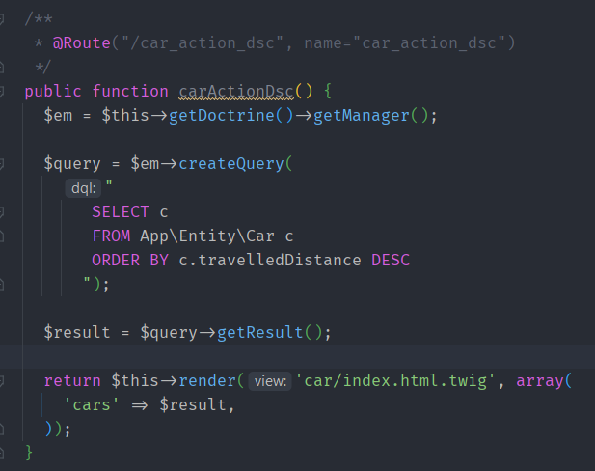
Entity Manager
Doctrine Query Language – DQL
Very similar to SQL
With DQL we can update, delete, select entities, but not persist
With DQL we select objects instead of table rows

Slide 15
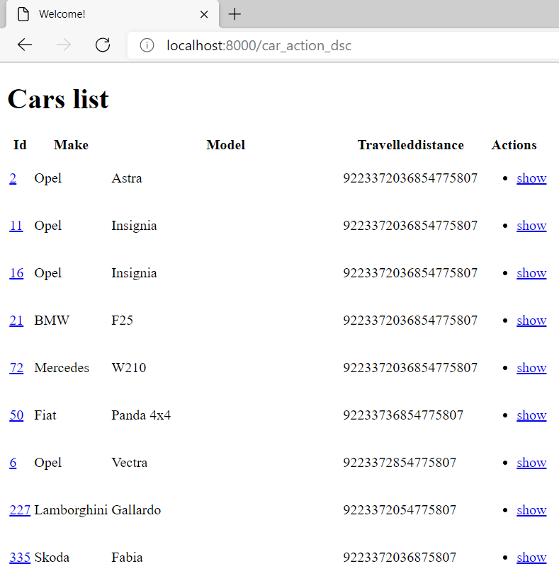

Slide 16
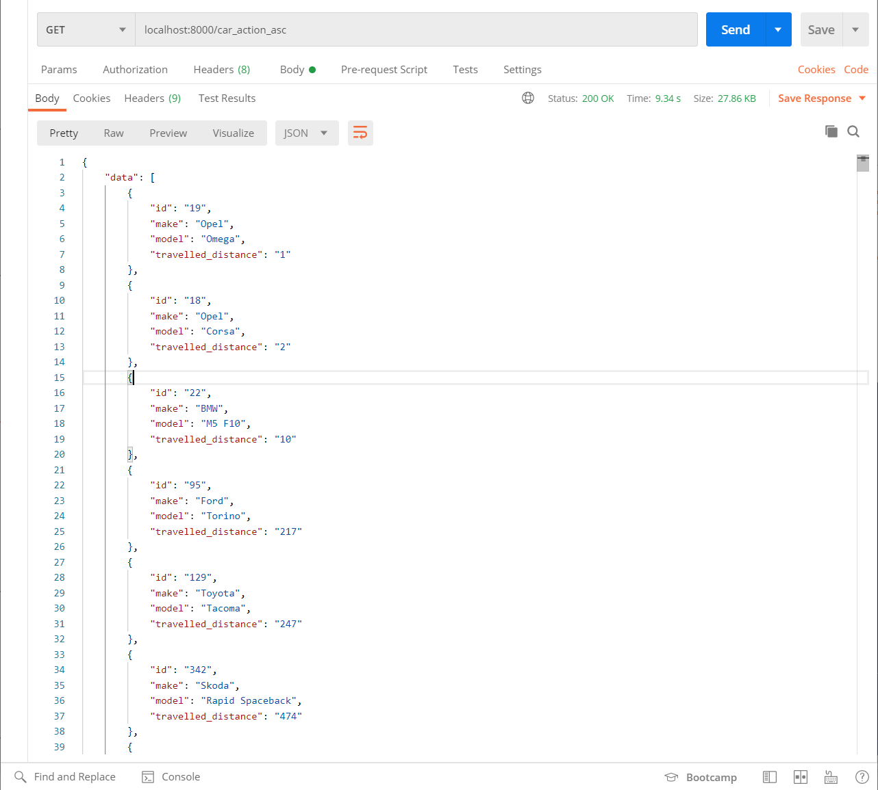
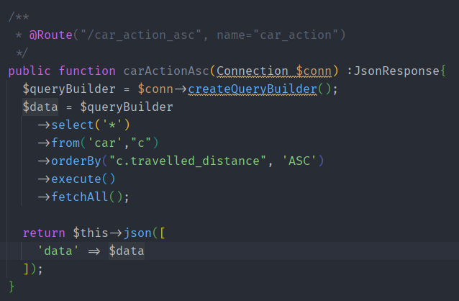
Entity Manager
Doctrine Query Builder
Create query in object oriented approach

Slide 17
Entity Repository
Entity Repository, Helper Methods

Slide 18
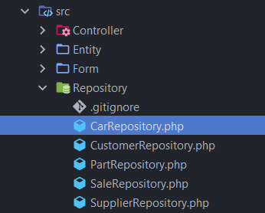
Entity Repository
Makes your code reusable
Isolates your queries from other logic
Provides access to helper methods for each property of your entity

Slide 19
Entity Repository Class
Automatically created when executing:
Above command will generate Doctrine Entity and empty repository class
php bin/console make:entity SomeClass

Slide 20
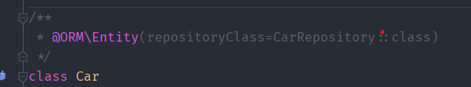
Entity Repository Class
Manually Configure repository Class in your entity

Slide 21
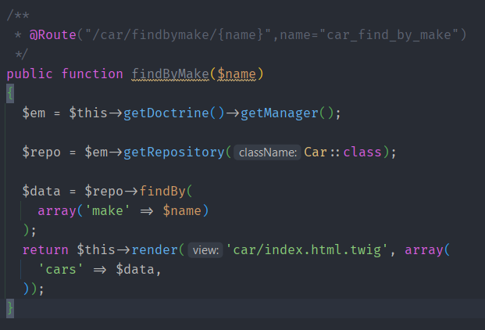
Entity Repository Class
Extending ServiceEntityRepository allows us to access dynamic helper methods for each mapped entity property
Now you have dynamic method names for our entity properties without writing single line of code

Slide 22
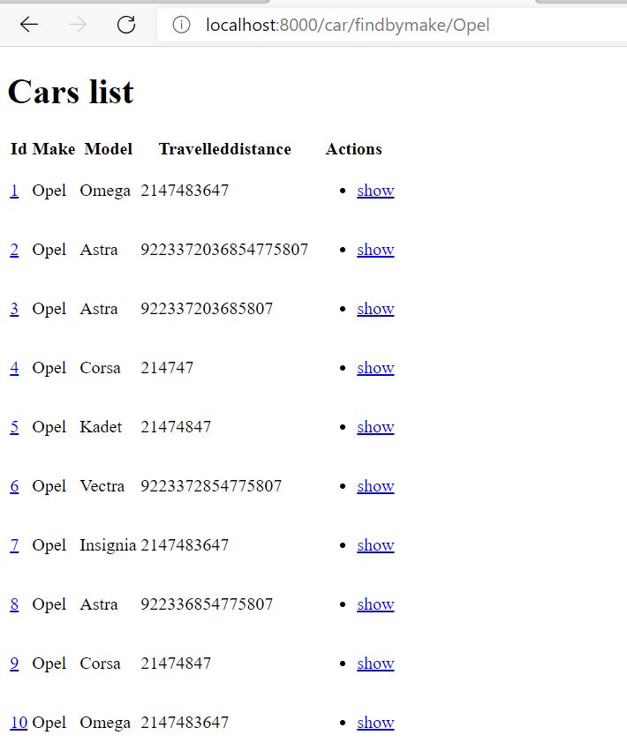

Slide 23
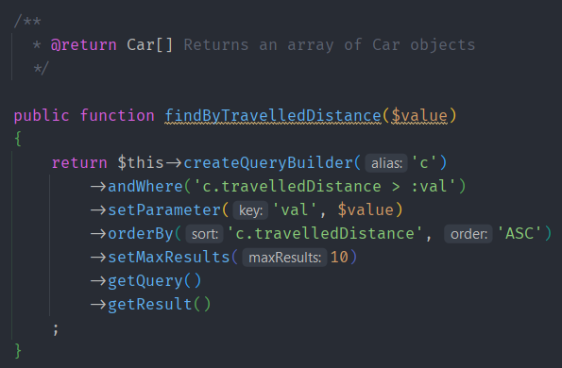
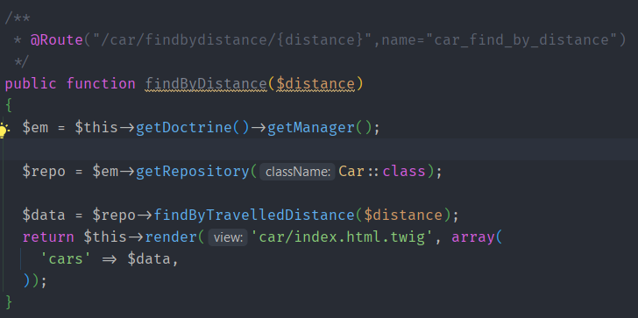
Entity Repository Class
How to access the EntityManager in your repository class

Slide 24
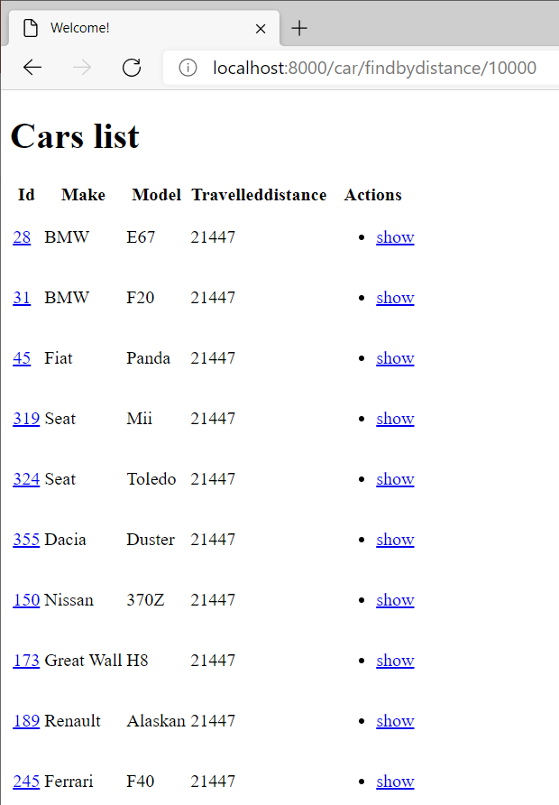

Slide 25
Summary
Doctrine ORM
Basic entity mapping
DBAL
Entity Repository

